Slide 1
Project-3
GLOBAL PROSPECTIVE ON COVID 19

Slide 2
WHAT DID WE LOOK AT
Analysis on COVID 19, vaccinations, and their impacts on:
The U.S
Countries Around the World

Slide 3
Data sources
WORLD HEALTH ORGANIZATION (WHO)
Johns Hopkins Coronavirus Resource Center (cases, deaths, incidents rate, fatality ratio)
The New York Times (cases, deaths, etc.)
CNN.com (travel restrictions)

Slide 4
DATABASES
LIBRARIES
BOOSTRAP
PLOTLY
MATPLOTLIB
LEAFLET
SKLEARN
NUMPY
LANGUAGES
JAVASCRIPT
HTML
CSS
PYTHON
PANDAS
TABLEAU
JAVASCRIPT

Slide 5
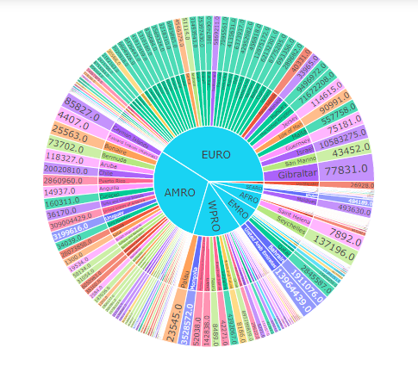
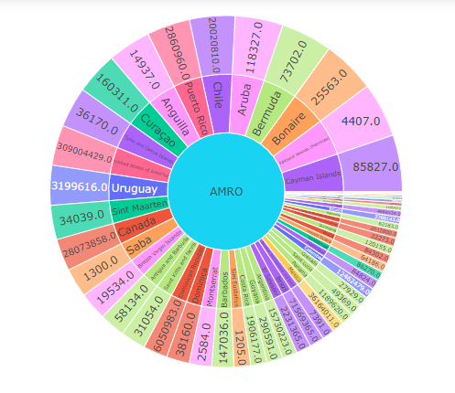
Jordan
Sunburst charts are awesome!

Slide 6
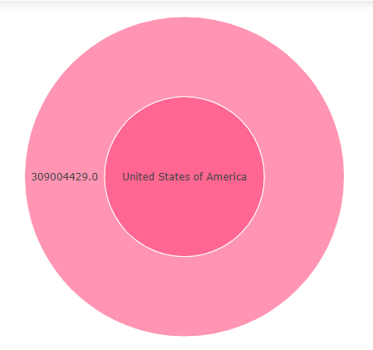
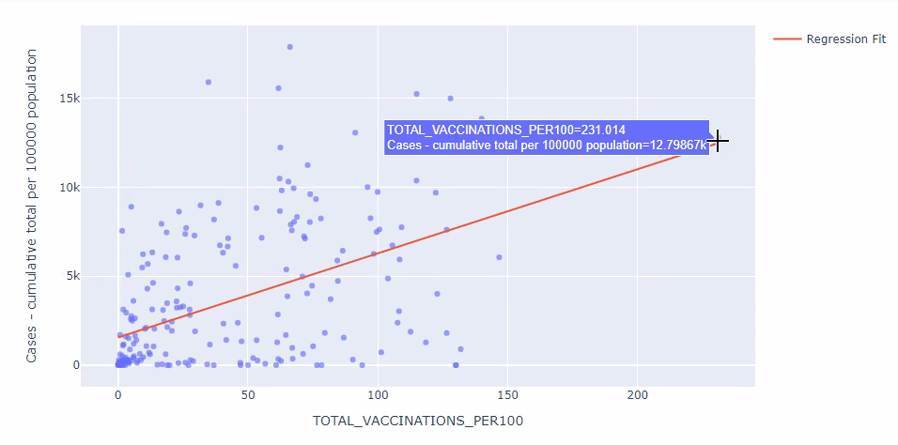
Jordan
The sunburst chart is an interactive chart that gives a refreshing way to view data from various sources all encompassed in one neat platform.

Slide 7
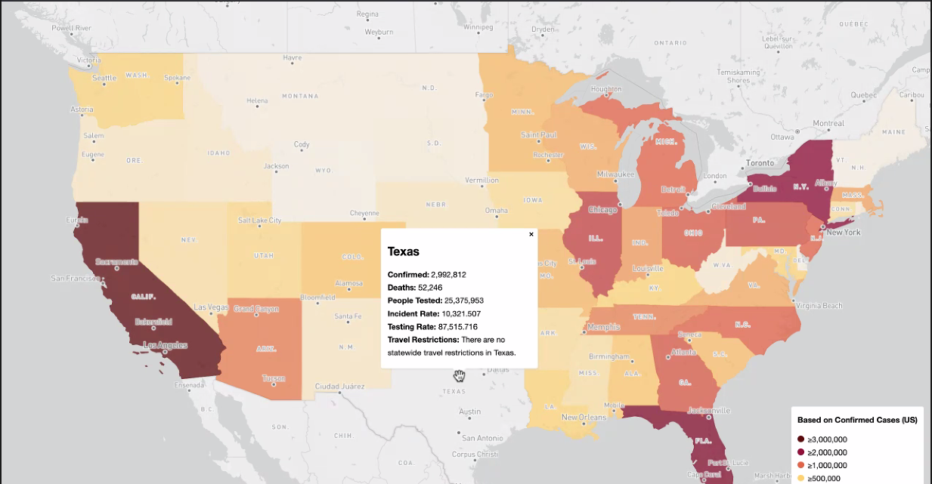
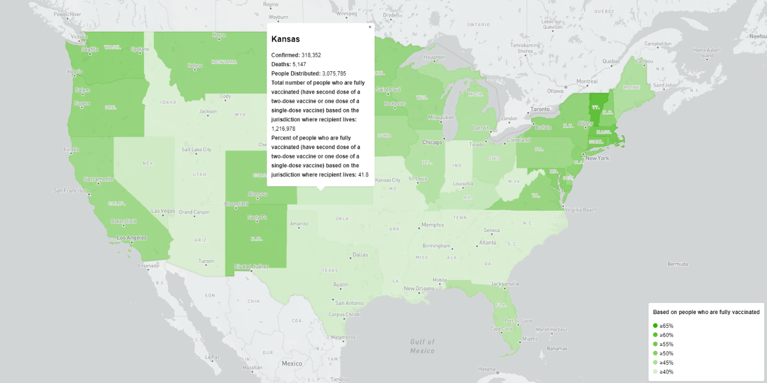
Mohammed

Slide 8

Explanation
Map 1: Current coronavirus status in the US. The data shown in the map is currently until the 26th of this month, except the travel restrictions (22 of May). The map clearly shows that most popular states are the most impacted from COVID.
Map 2: This map shows the percentage of vaccinated people to the total population of the state. No state has a percentage less than 30%. Most of the states are between 40 to 55%. Which reflects the total US vaccinated population of ~47% (today).

Slide 9
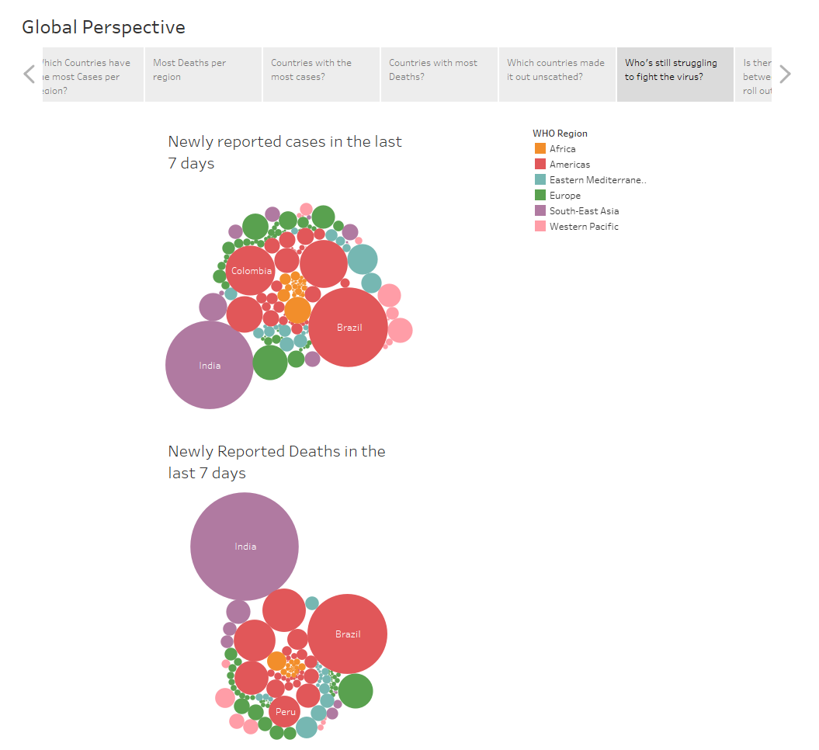
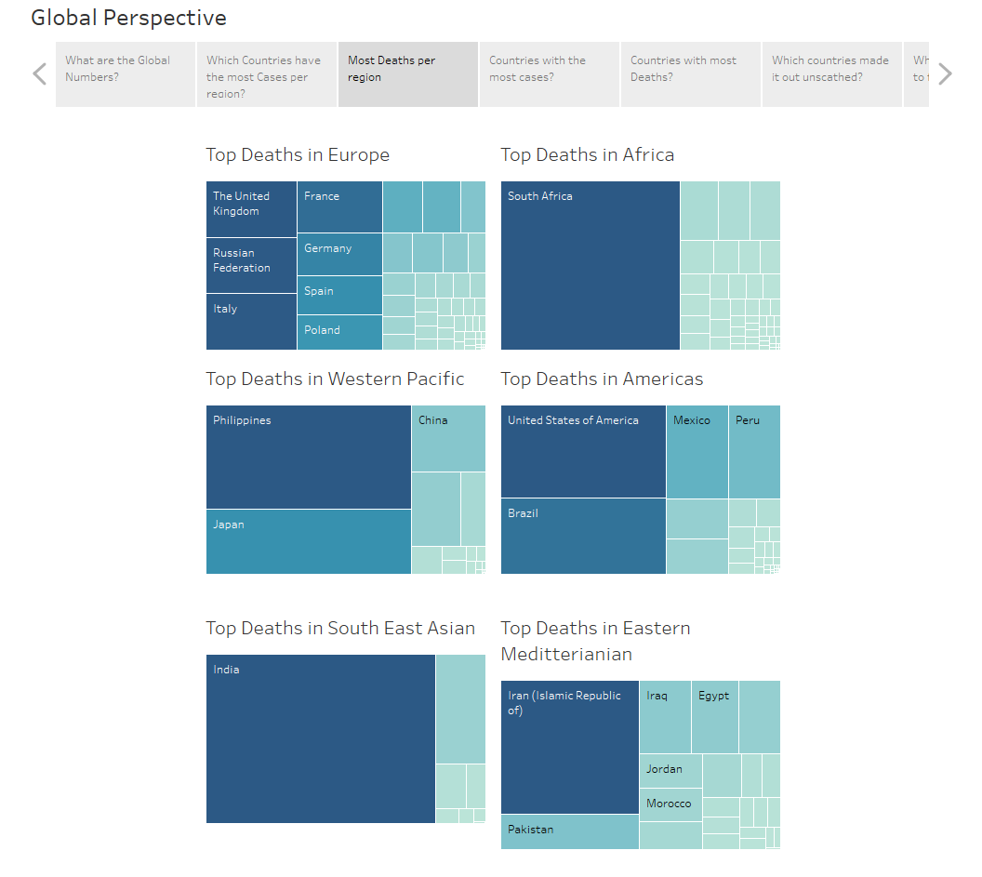
Global prospective
TABLEAU (dashboards)
FILTERS
COLOR
SIZE
TEXT
DETAILS

Slide 10
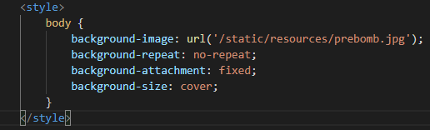
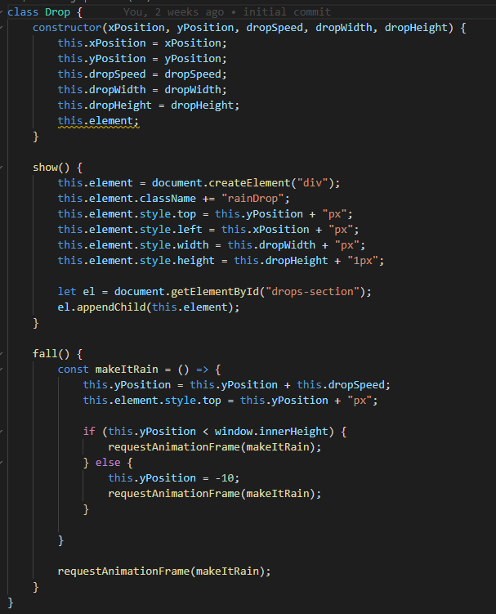


John
CSS & JS CODE

Slide 11
What worked
Data Synchronization
Teamwork
Data Collection
Website development
Cooperation

Slide 12
Roadblocks
Time
Data
Editing data
Resources
Having enough tasks for each team member

Slide 13
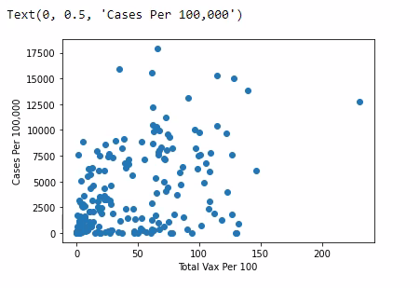
Final analysis
The data showed inconclusive evidence that vaccinations attribute to a decline in covid cases

Slide 14
fin
WHATS NEEDED
Time
More Variables
Accurate Reporting
Covid Guidance

